Slide 1
SIDP – Hail Storm Demonstration Scenario, Insurance

Slide 2
Scenario 1: Setting the scene
Demonstrator Scene
  National disaster claims centre for Metropolitan Insurance Company (MIC)
Type of Incident
  Damage prevention and assessment as the result of a severe thunderstorm
Incident Site
  Liverpool / Blacktown NSW
Main Actors
  Nicole – national claims manager
  Brian – console operator

Slide 3
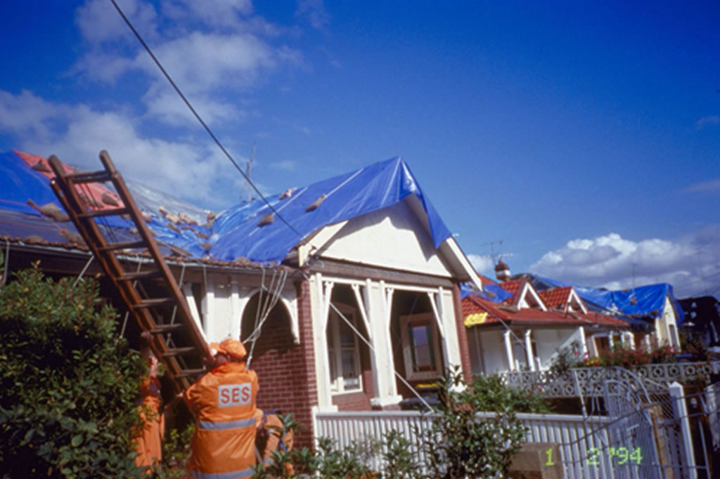
What will we be seeing?
1. Live data alert
2. Preventive Action
3. Impact Analysis
4. Claims Analysis
5. Publishing

Slide 4
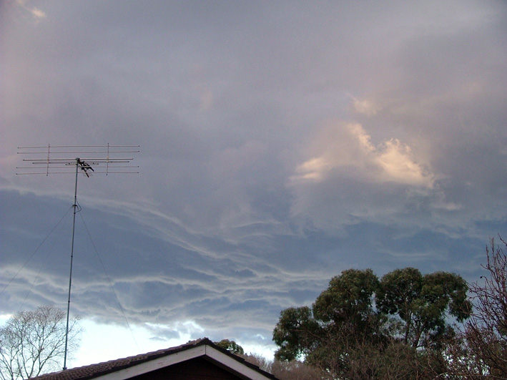
Scene 1 - Storm warning comes in
1. Live data alert
Mid-afternoon on a busy weekday
Storm approaching Liverpool, tracking south-easterly
BOM issues severe weather alert for Liverpool area
Brian is on duty in MIC control centre
Receives the severe weather alert and previews alert
2. Preventive Action
3. Impact Analysis
4. Claims Analysis
5. Publishing

Slide 5
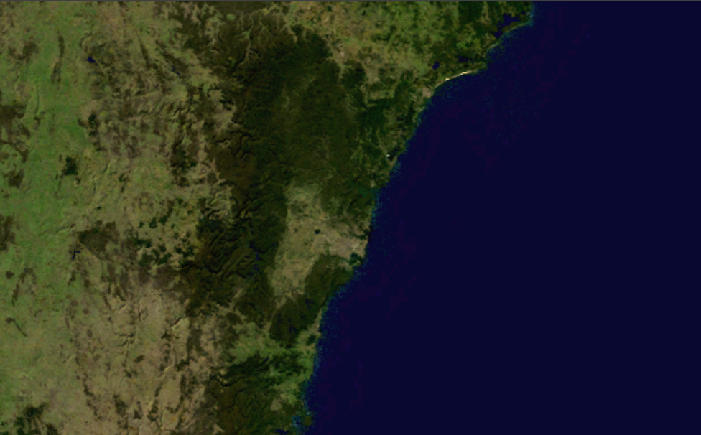
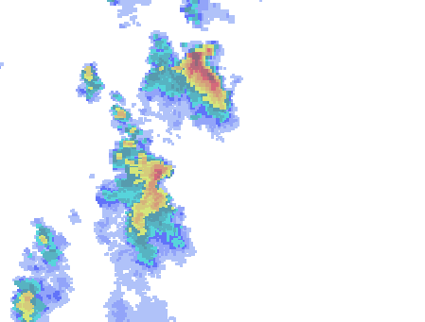





A storm is advancing into the Sydney Area
The BOM Radar detects the thunderstorm…
And broadcasts a warning email
The Metropolitan Insurance Co receive the email
1.1

Slide 6


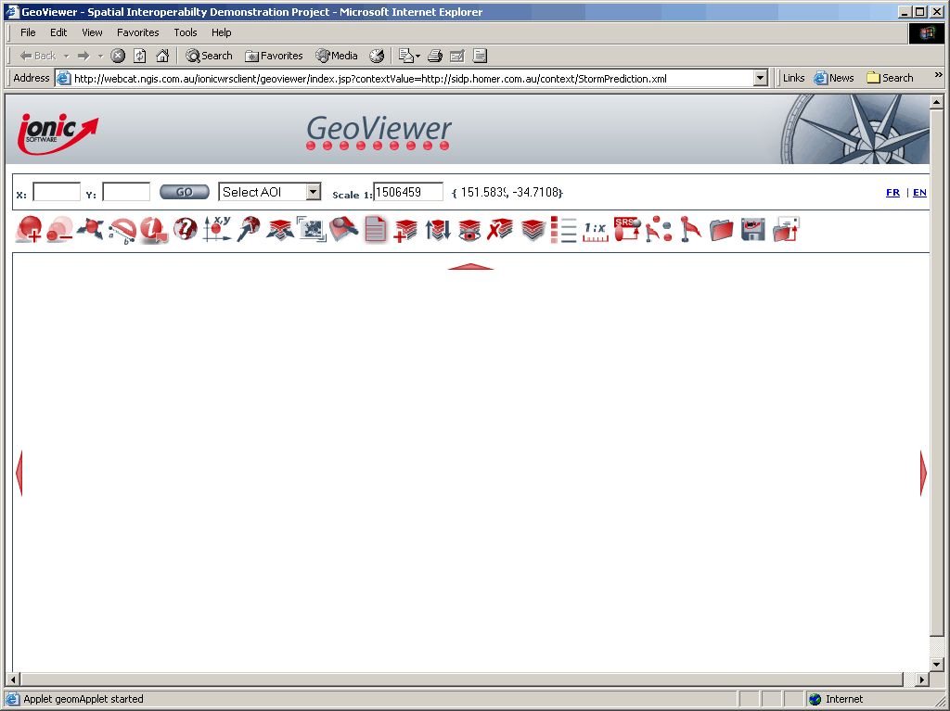

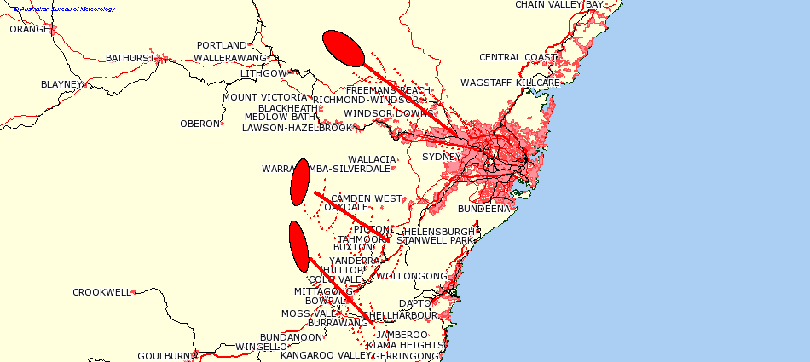

The Map Viewer is loaded from Perth
In turn, the viewer loads the predefined map…
1.1

Slide 7


Scene 2 – Potential threat assessment
1. Live data alert
Brian starts up MIC GIS System
Adds live weather feeds from BOM on his console
Nicole defines “threat zone”
Asks to see impact on MIC’s policy portfolio
  Property & Motor vehicles
  # of policy holders affected
  Total insured value
  Estimated Claims exposure
Instructs call centre not to accept any more business in the area
2. Preventive Action
3. Impact Analysis
4. Claims Analysis
5. Publishing

Slide 8
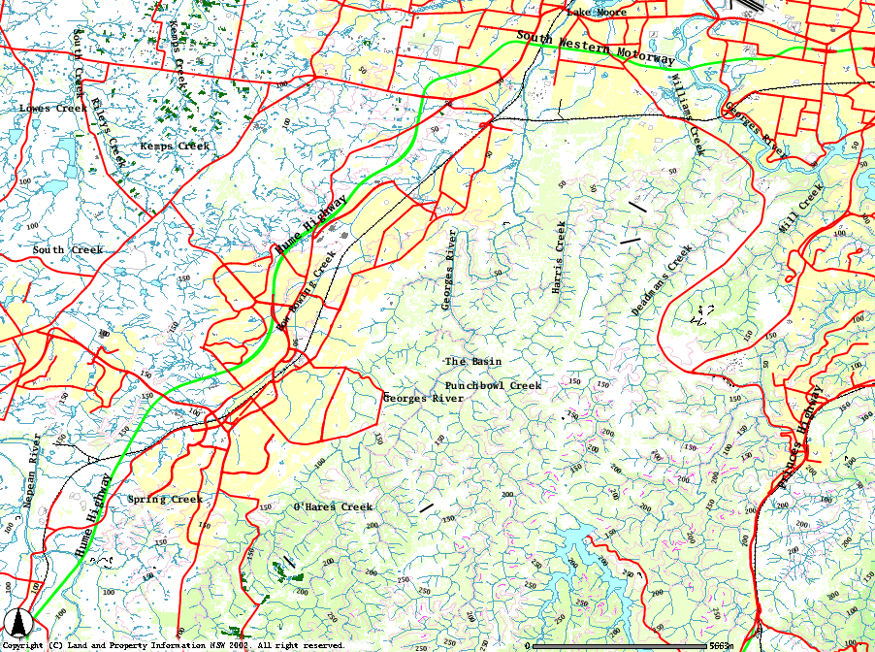




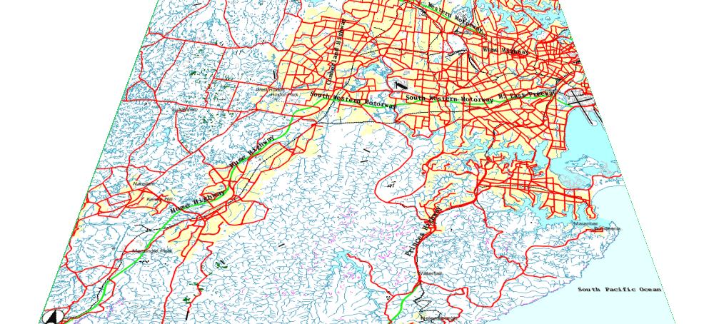




The MIC GIS reads in base mapping from PSMA…
Weather information from the Bureau of Meteorology
and adds policy holders from the MIC database
1.2

Slide 9

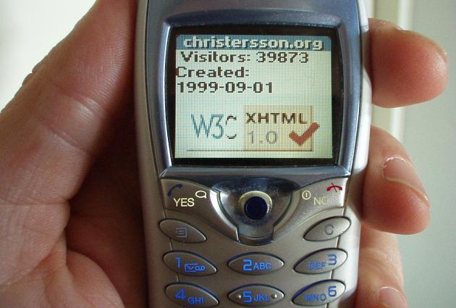
Scene 2 - Proactive damage prevention
Customer calls wishing to take out a new policy
  CRM alerts operator that the address falls inside threat zone
  Customer unable to take out a policy at this time
Nicole asks Brian to issue an SMS alert to affected policy holders
1. Live data alert
2. Preventive Action
3. Impact Analysis
MIC alert: storm warning for Liverpool area. Take precautions to protect your home and car from damage.
4. Claims Analysis
5. Publishing

Slide 10
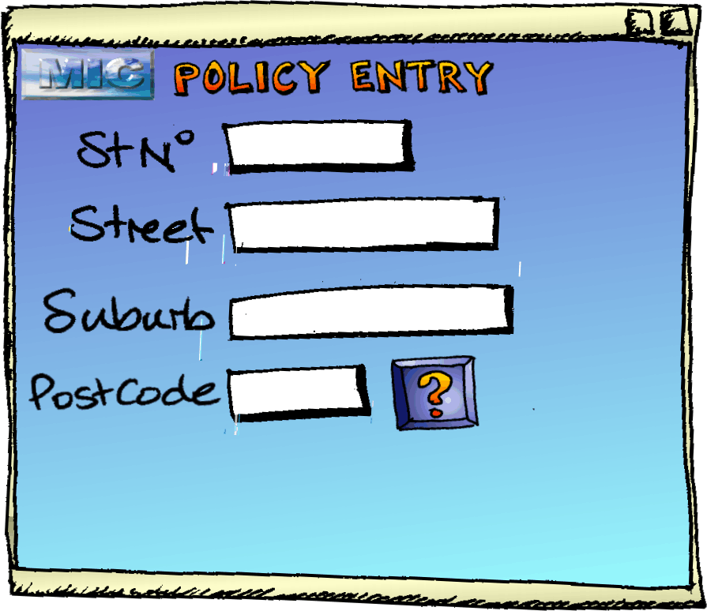






Policy Entry tests for addresses in the Exclusion Zone
1.3

Slide 11

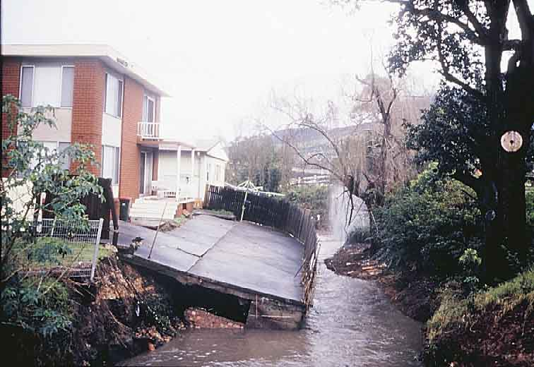
Scene 3 - Initial damage assessment
1. Live data alert
Within hours, MIC starts receiving claims.
  All calls are logged and geocoded.
Early indications that severe damage is concentrated in 3 areas
  Based on claims concentration and (verbal) SES reports
  Warwick Farm, Lansvale & Chipping Norton
Brian creates initial damage/affected areas
Nicole arranges for a contractor to fly the affected areas to take high resolution aerial photography.
2. Preventive Action
3. Impact Analysis
4. Claims Analysis
5. Publishing

Slide 12
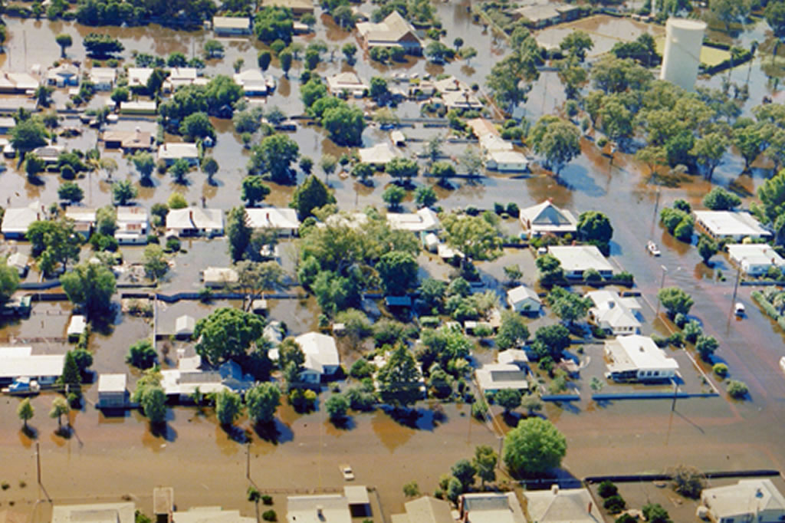
Scene 3 – Impact analysis
1. Live data alert
Aerial photography contractor provides imagery via a web service
Brian starts specialised Image Analysis tool
  Compares “before” and “after” imagery
  Refines affected areas
2. Preventive Action
3. Impact Analysis
4. Claims Analysis
5. Publishing

Slide 13
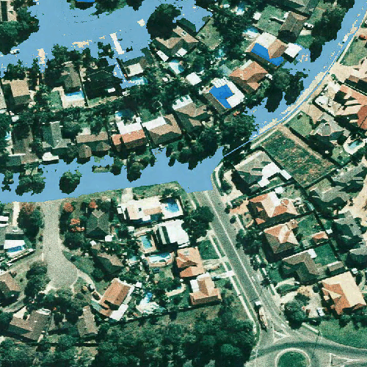


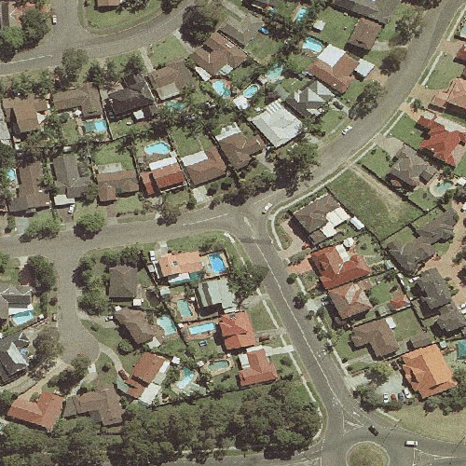
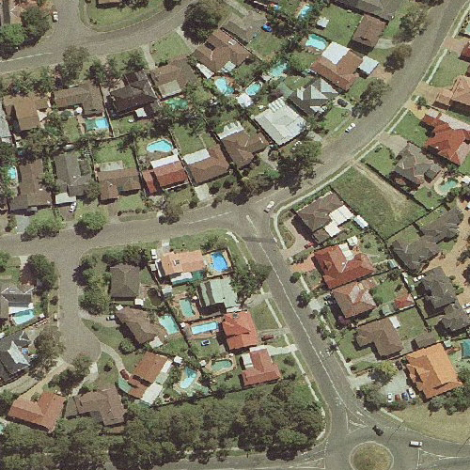





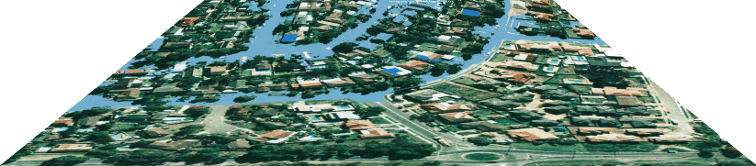
New aerial photography is flown…
And compared with previous archival photography
To define affected areas
1.5-1.7

Slide 14

Scene 4 – Claims analysis
1. Live data alert
Nicole spots inconsistencies in expected pattern of claims
  Claims outside affected areas
  Policy holders in affected areas not submitting claims
Earmarks these claims/policies for further investigation
2. Preventive Action
3. Impact Analysis
4. Claims Analysis
5. Publishing

Slide 15
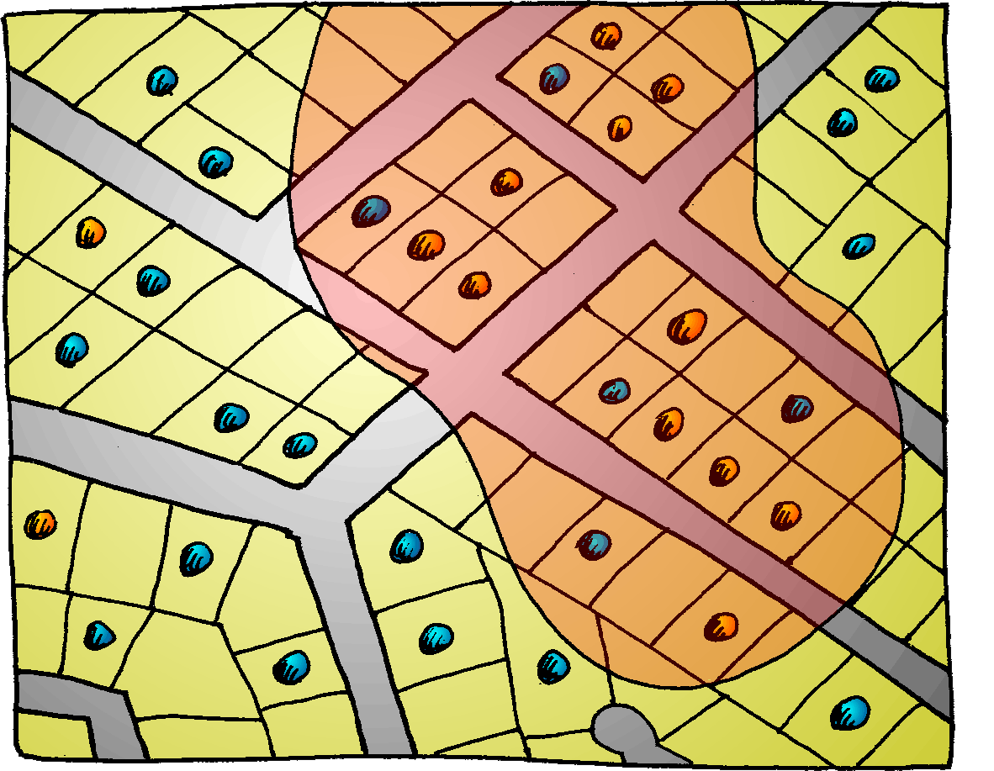


Spatial analysis of claims
Policies
Claims
Claim in affected area
No claim in affected area
Claim NOT in affected area
1.8

Slide 16

Scene 5 - Publishing
1. Live data alert
Brian prepares customised map data and publishes this on the MIC Intranet for loss assessors to use
2. Preventive Action
3. Impact Analysis
4. Claims Analysis
5. Publishing

Slide 17
What did we see?
1. Live data alert
Weather alert issued with live data viewer
  Helps MIC assess event significance
2. Preventive Action
Predicted storm track helps define threat area
  Exclude new policies; warn policy holders by SMS
  Save time and money
3. Impact Analysis
“Before” and “after” imagery services
  Change analysis
  Accurately define affected areas
4. Claims Analysis
Identify anomalies
  Better service delivery
  Efficient use of resources
5. Publishing
Publish once, use many
  Standard maps to assist assessors

